Slide 1

PIZZAHUT PROJECT - SQL
Analyzing Sales and Operations with SQL Queries

Slide 2
About Project
Project Overview
The SQL project focuses on analyzing Pizza Hut's data to gain insights into sales and operations.
Utilizing a variety of SQL queries, the project aims to identify key business metrics and trends. The
data includes customer details, orders, order details, product information, and employee
records.
Objectives
Customer Segmentation: Identify top customers based on the number of orders placed.
Sales Analysis: Calculate total sales per product.
Monthly Revenue: Determine the total revenue generated each month.
Employee Performance: Evaluate employee performance based on the number of order handled.
Popular Products: Identify the most popular products based on sales quantity.
Revenue by Customer Region: Analyze revenue distribution across different customer
regions.

Slide 3
Queries Solved
1. Total Revenue
2. Average Order Value
3. Total Pizzas Sold
4. Total Orders
5. Average Pizzas Per Order
6. Daily Trend for Total Orders
7. Monthly Trend for Orders
8. Percentage of Sales by Pizza Category
9. Percentage of Sales by Pizza Size
10. Total Pizzas Sold by Pizza Category
11. Top 5 Pizzas by Revenue
12. Bottom 5 Pizzas by Revenue
13. Top 5 Pizzas by Quantity
14. Bottom 5 Pizzas by Quantity
15. Top 5 Pizzas by Total Orders
16. Bottom 5 Pizzas by Total Orders

Slide 4
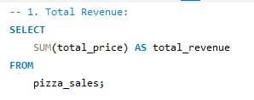

Total Revenue

Slide 5
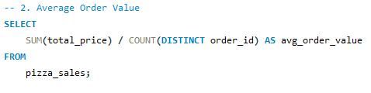

Average Order Value.

Slide 6
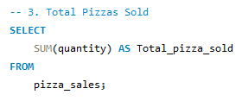

Total Pizzas Sold.

Slide 7
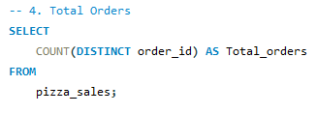

Total Orders

Slide 8
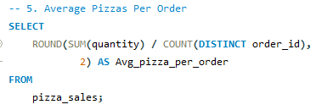

Average Pizzas per Order

Slide 9
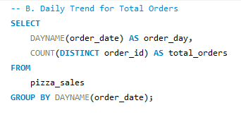
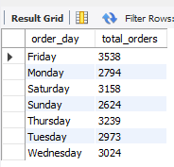
Daily Trend for Total Orders

Slide 10
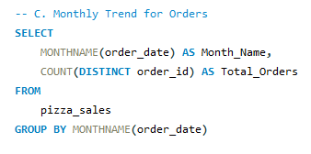
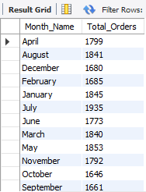
Monthly Trend for Orders

Slide 11
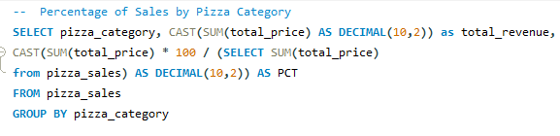
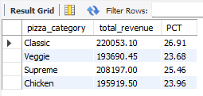
Percentage of Sales by Pizza Category

Slide 12
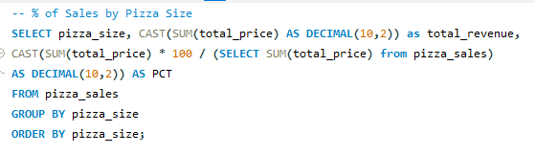
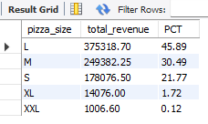
Percentage of Sales by Pizza Size

Slide 13
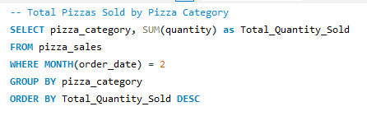
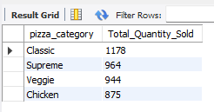
Total Pizza Sold by Pizza Category

Slide 14
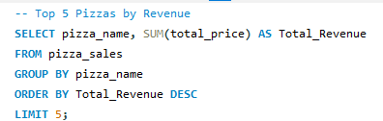
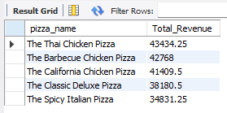
Top 5 Pizzas by Revenue

Slide 15
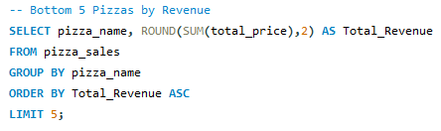
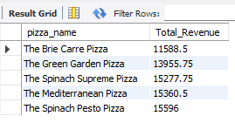
Bottom 5 Pizzas by Revenue

Slide 16
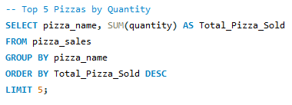
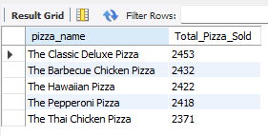
Top 5 Pizzas by Quantity

Slide 17
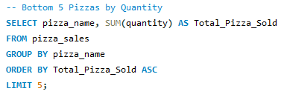
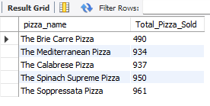
Bottom 5 Pizzas by Quantity

Slide 18
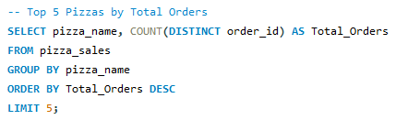
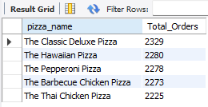
Top 5 Pizzas by Total Orders

Slide 19
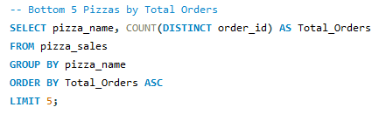
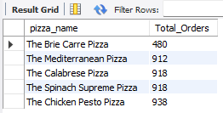
Bottom 5 Pizzas by Total Orders

Slide 20
THANK YOU
Made by : Rishav Raj

